Slide 1
Flight Difficulty Score Analysis
United Airlines Operations Optimization
Team Members:
SHIVEET RAINA 2K22/CO/439
AMIT SALUNKE 2K22/CO/400

Slide 2
Table of Contents
1. Executive Summary
2. Exploratory Data Analysis
• Average Delay and Performance Metrics
• Ground Time Analysis
• Baggage Analysis
• Passenger Load Analysis
• Special Service Requests Analysis
3. Flight Difficulty Score Development
4. Post-Analysis & Operational Insights
5. Recommendations

Slide 3
Executive Summary
Key Findings:
• Average departure delay: 21.18 minutes
• 49.61% of flights depart later than scheduled
• 14.61% of flights have tight ground time (≤10 min margin)
• High SSR flights show 37% more delay even with low passenger load
• International long-haul flights are consistently most difficult
• Primary difficulty drivers: long-haul flights, transfer bags, and special service requests

Slide 4
Exploratory Data Analysis: Performance Metrics
Q1: Average Delay and On-Time Performance
• Average Departure Delay: 21.18 minutes
• Percentage of Flights Departing Late (> 0 min delay): 49.61%
• Nearly half of all flights experience delays
• Significant operational inefficiency exists

Slide 5
Exploratory Data Analysis: Ground Time
Q2: Ground Time Constraints
• Flights with Scheduled Ground Time Margin ≤ 10 mins: 1,183
• Percentage of Tight Turn Flights: 14.61%
• Tight turns create operational pressure
• Risk of cascading delays across flight network

Slide 6
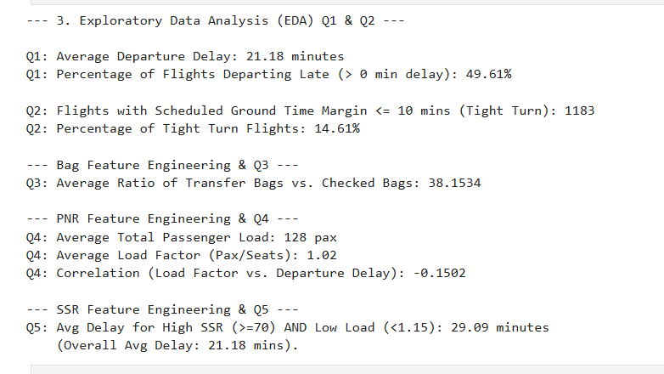

Slide 7
Exploratory Data Analysis: Baggage
Q3: Transfer vs. Checked Bags
• Average Ratio of Transfer Bags vs. Checked Bags: 38.15
• High transfer bag ratio indicates connection complexity
• Transfer bags require additional handling and coordination
• Key driver of operational difficulty

Slide 8
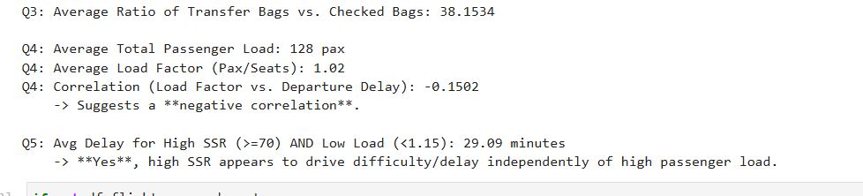
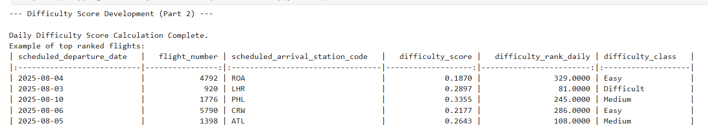

Slide 9
Exploratory Data Analysis: Passenger Load
Q4: Passenger Load Analysis
• Average Total Passenger Load: 128 passengers
• Average Load Factor (Pax/Seats): 1.02
• Correlation (Load Factor vs. Departure Delay): -0.15
• Surprising negative correlation suggests other factors more impactful

Slide 10
Exploratory Data Analysis: Special Service Requests
Q5: Special Service Requests Impact
• Avg Delay for High SSR (≥70) AND Low Load (<1.15): 29.09 minutes
• Overall Average Delay: 21.18 minutes
• High SSR flights show 37% more delay even with low passenger load
• Special service requests are significant independent driver of delays

Slide 11
Flight Difficulty Score Development
Methodology:
• Daily-resetting scoring approach
• Features included:
- Turn pressure score (25% weight)
- Transfer bags (20% weight)
- Special service requests (20% weight)
- Passenger load (10% weight)
- Other factors (25% weight)
• Daily min-max scaling for normalization
• Classification: Difficult (top 20%), Medium (20-50%), Easy (bottom 50%)

Slide 12
Difficulty Score Results
Example of Top Ranked Flights:
• Flight 4792 to ROA (Aug 4): Easy classification
• Flight 920 to LHR (Aug 3): Difficult classification
• Flight 1776 to PHL (Aug 10): Medium classification
• Flight 5790 to CRW (Aug 6): Easy classification
• Flight 1398 to ATL (Aug 5): Medium classification
• International flights consistently ranked higher difficulty

Slide 13
Post-Analysis: Most Difficult Destinations
Top 5 Most Consistently Difficult Destinations:
1. GRU (São Paulo) - 100% difficult flights
2. BRU (Brussels) - 100% difficult flights
3. FRA (Frankfurt) - 100% difficult flights
4. ATH (Athens) - 100% difficult flights
5. HND (Tokyo Haneda) - 100% difficult flights
• All top difficult destinations are international long-haul flights

Slide 14
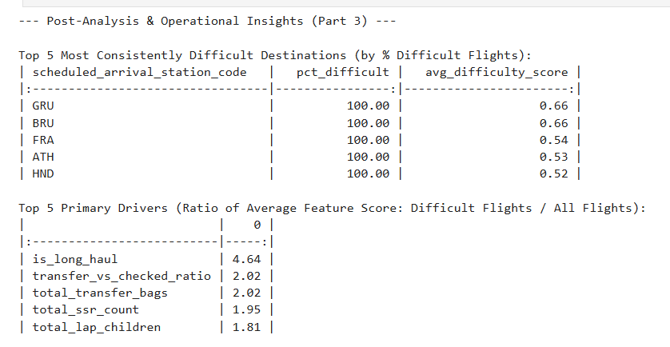

Slide 15
Post-Analysis: Primary Difficulty Drivers
Top 5 Primary Drivers (Impact Ratio):
1. Long-haul flights (4.64x impact)
2. Transfer vs. checked bag ratio (2.02x impact)
3. Total transfer bags (2.02x impact)
4. Special service requests (1.95x impact)
5. Lap children (1.81x impact)
• Long-haul international flights are overwhelmingly the top difficulty factor

Slide 16
Operational Recommendations
1. Tight Turn Mitigation
• Implement 15-minute gate buffer for high turn pressure flights
• Assign high-pressure flights to low-complexity gates
2. Baggage Prioritization
• Pre-assign dedicated ramp agents for high transfer bag flights
• Confirm resource allocation 60 minutes before arrival
3. Service Triage
• Assign most experienced teams to high SSR flights
4. Resource Indexing
• Integrate daily difficulty rank into shift allocation tool

Slide 17
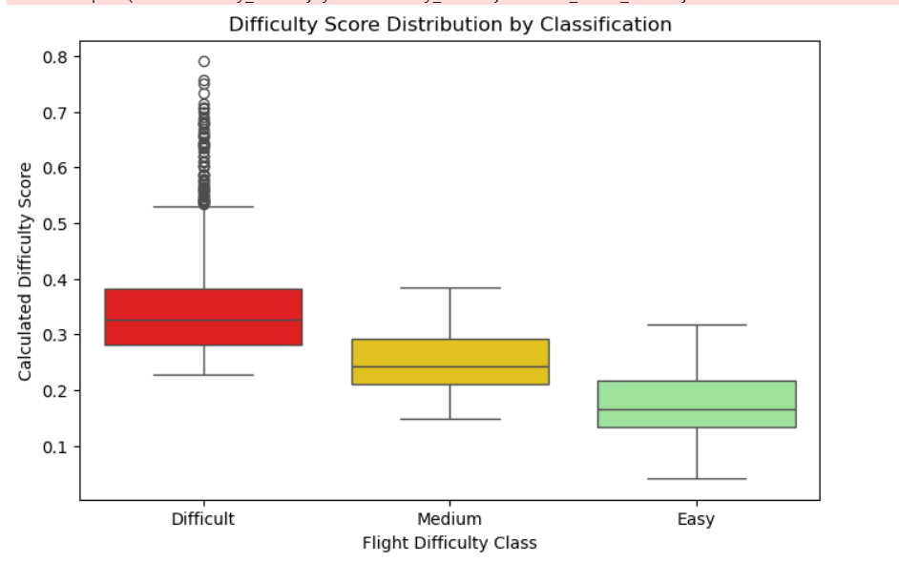

Slide 18
Conclusion
Key Takeaways:
• Flight Difficulty Score effectively quantifies operational complexity
• International long-haul flights present greatest challenges
• Special service requests significantly impact delays regardless of load
• Transfer bags create substantial operational complexity
• Data-driven approach enables proactive resource allocation
• Implementation of recommendations can improve on-time performance

Slide 19
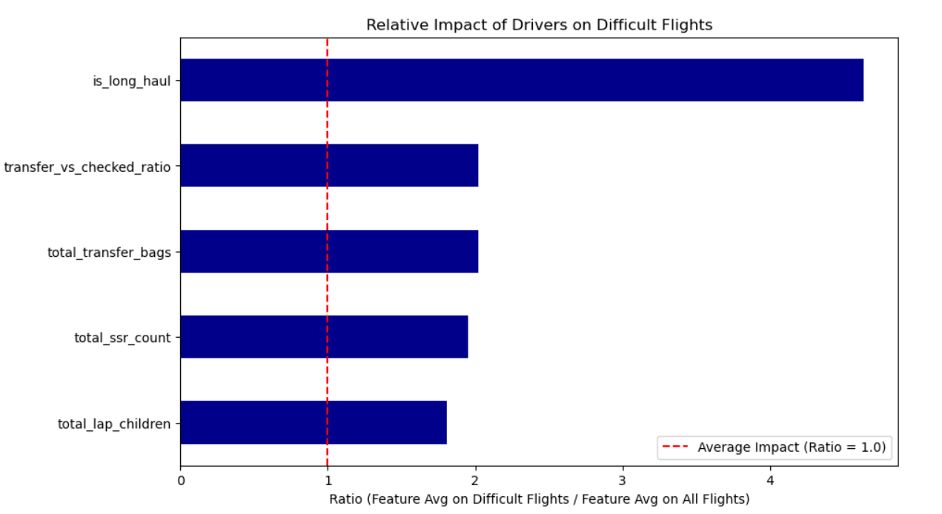

Slide 20
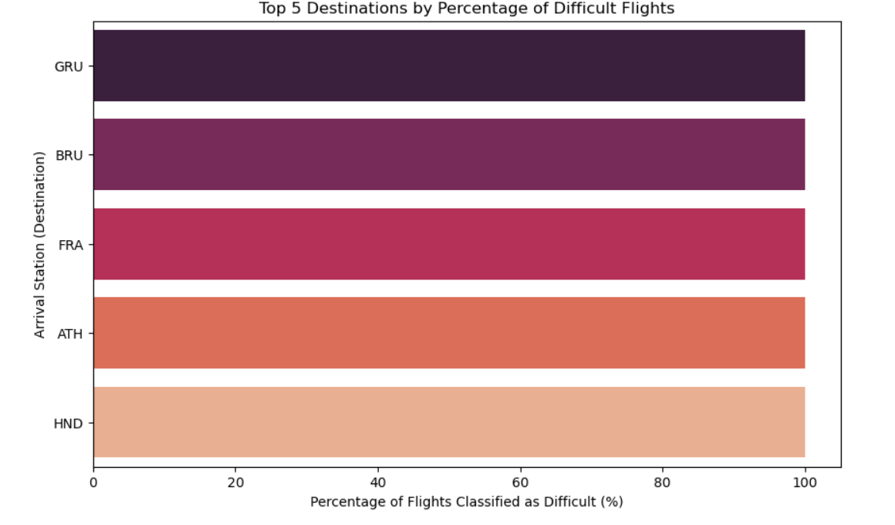

Slide 21
Thank You
Questions & Answers

